Slide 1
公司概况 Company Overview
Anyang Xinye Technology Co., Ltd. was registered and established on March 22, 2024.
Located on Industrial Second Road and Zhangshen Road in Zhanglong Township Development Zone, Neihuang County, Anyang City, Henan Province,At the southeast corner of intersection 1-9.
There are 4 standard factory buildings with a total area of 15600 square meters.
And there are already 20 of them Years of production and export sales of Christmas lights, solar lights, and courtyard decorative lights.
We have served a wide range of consumers with high-quality products and reasonable prices.
XINYE LIGHT represents advanced products and stable quality in Europe.
The company's main product types include: conventional light string, RGB point control light string, and wrought iron shaped light Decoration, solar outdoor decorative lights, and other multiple sections.

Slide 2
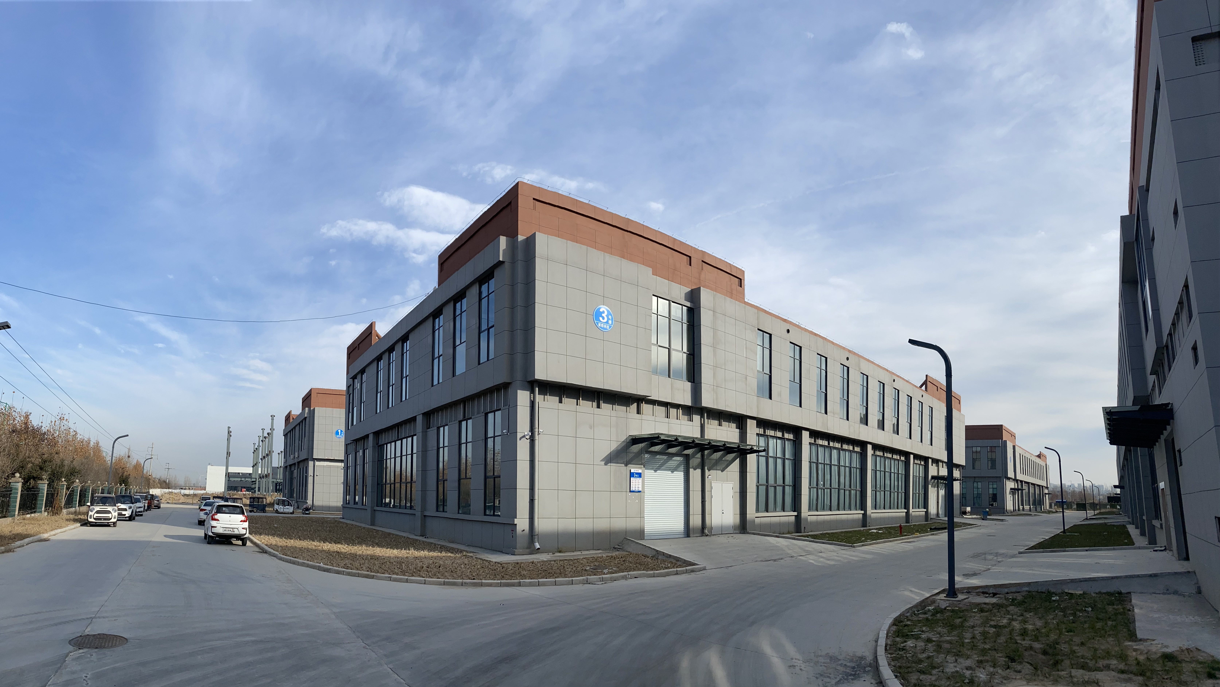
工厂简介
Company/Factory Profile

Slide 3
主要客户
Major Customers

Slide 4
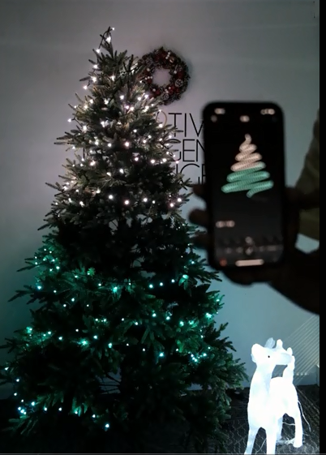
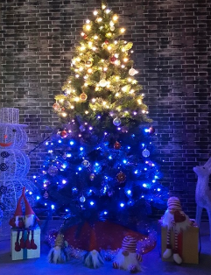
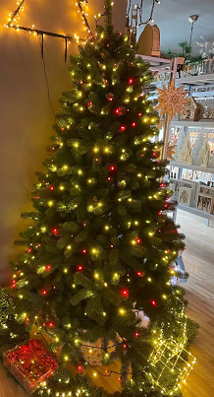
核心产品
Core Products
RGB bulb light chain with APP
RBWW bulb light chain with RF remote control

Slide 5
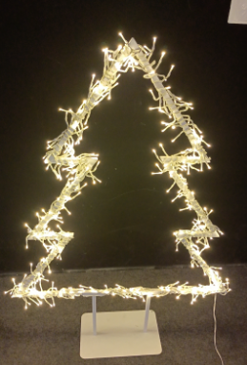
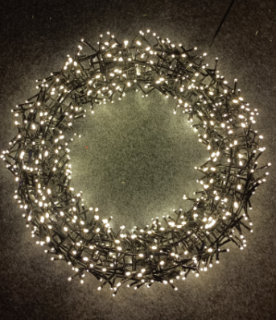
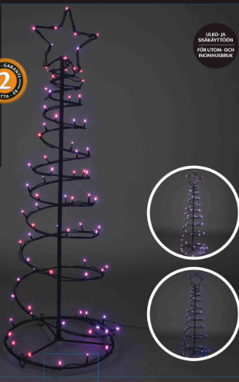
核心产品
Core Products
Metal frame Star with dual-chip bulb
Metal frame Ring with dual-chip bulb
RGB spiral metal tree light

Slide 6
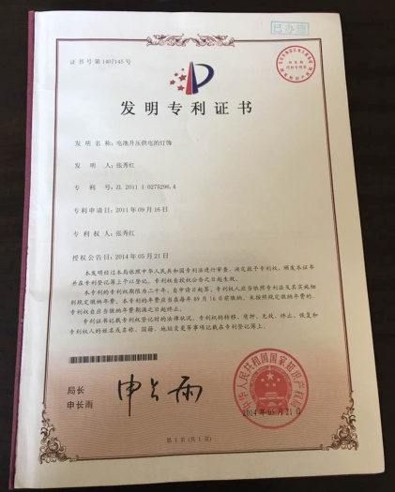
部分专利
Partial patents
Notes:
Elaborate within 2 slides on company background and history

Slide 7
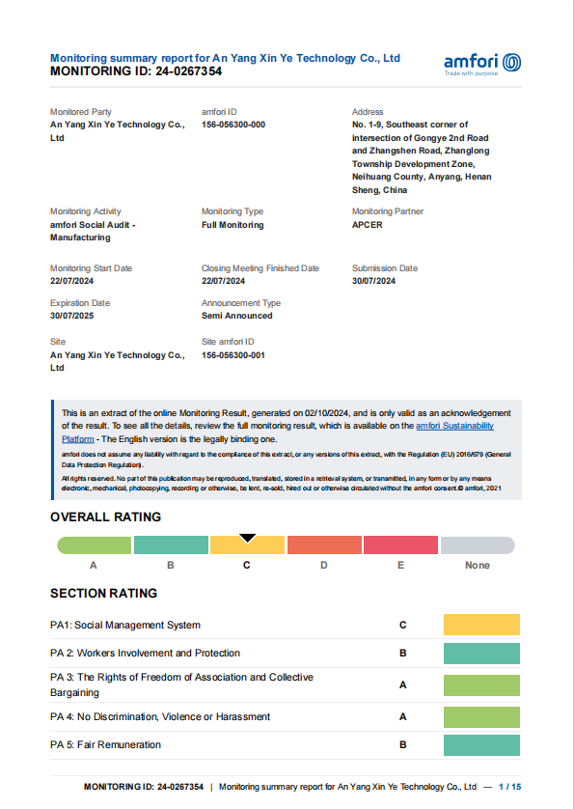
工厂认证
Factory certification
Notes:
Elaborate within 2 slides on company background and history

Slide 8
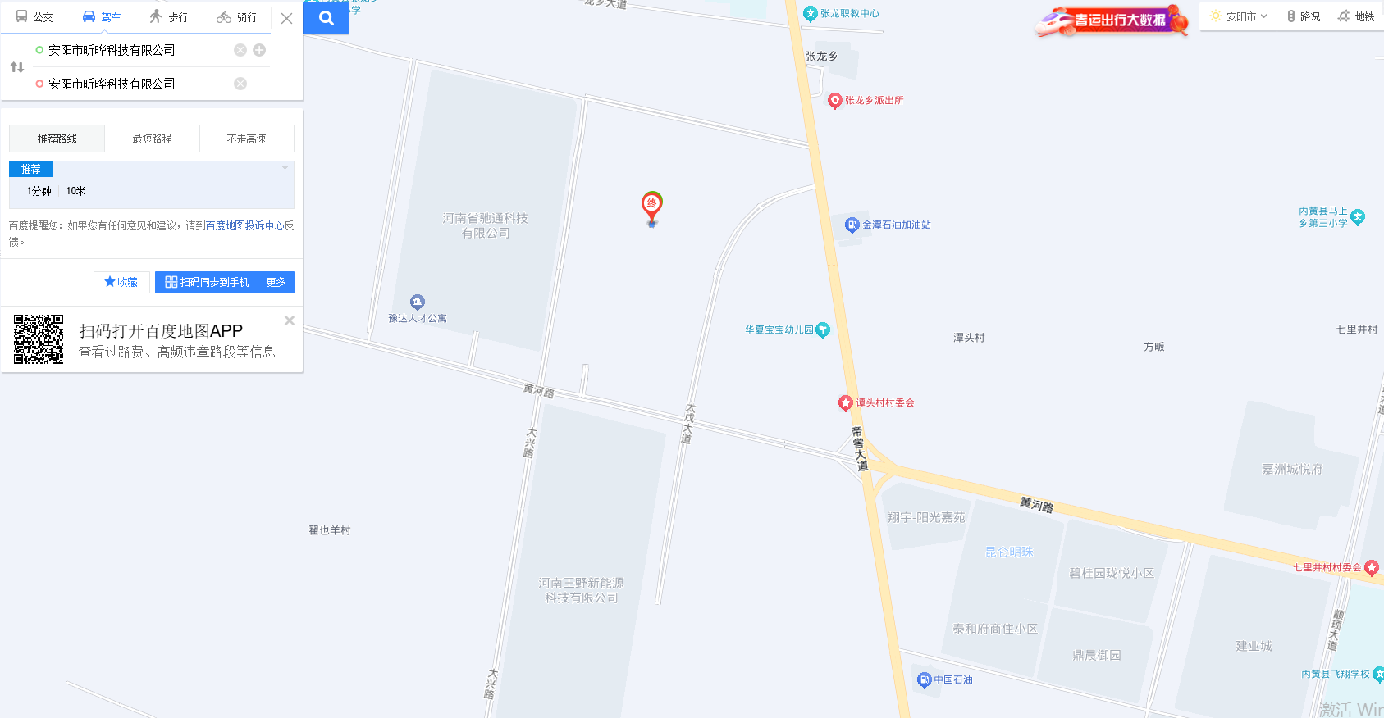
工厂地址及经纬度
Factory address and latitude and longitude
Located on Industrial Second Road and Zhangshen Road in Zhanglong Township Development Zone, Neihuang County, Anyang City, Henan Province,At the southeast corner of intersection 1-9.
East Longitude114°35′—114°59′, North Latitude35°39′—36°09′
Notes:
Elaborate within 2 slides on company background and history

Slide 9
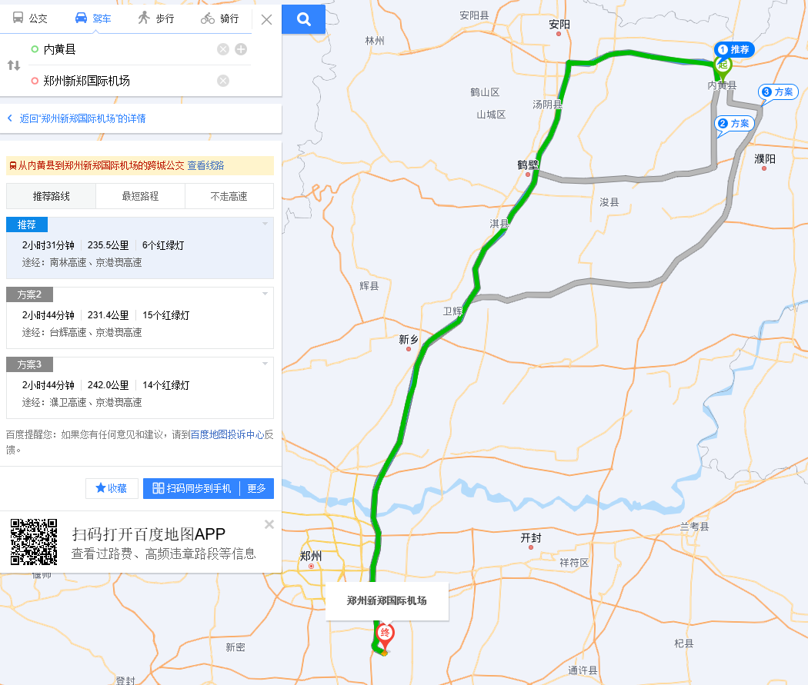
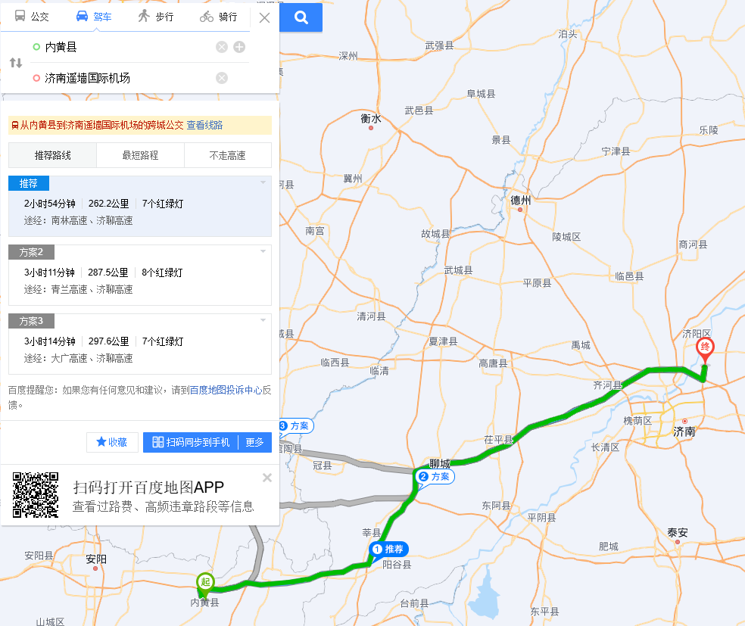
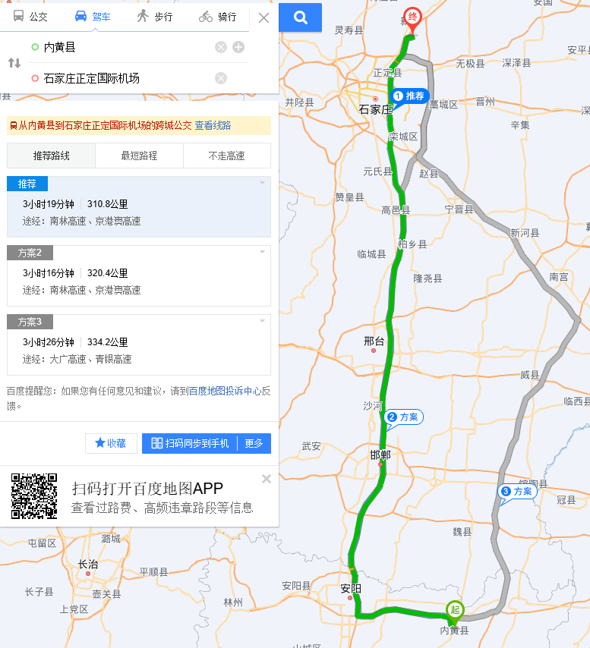
周边机场及距离
Surrounding airports and distance
距离郑州新郑机场235km
235km away from Zhengzhou Xinzheng Airport
距离济南遥墙机场262km
262km away from Jinan Yaoqiang Airport
距离石家庄正定机场262km
262km away from Shijiazhuang Zhengding Airport
Notes:
Elaborate within 2 slides on company background and history

Slide 10
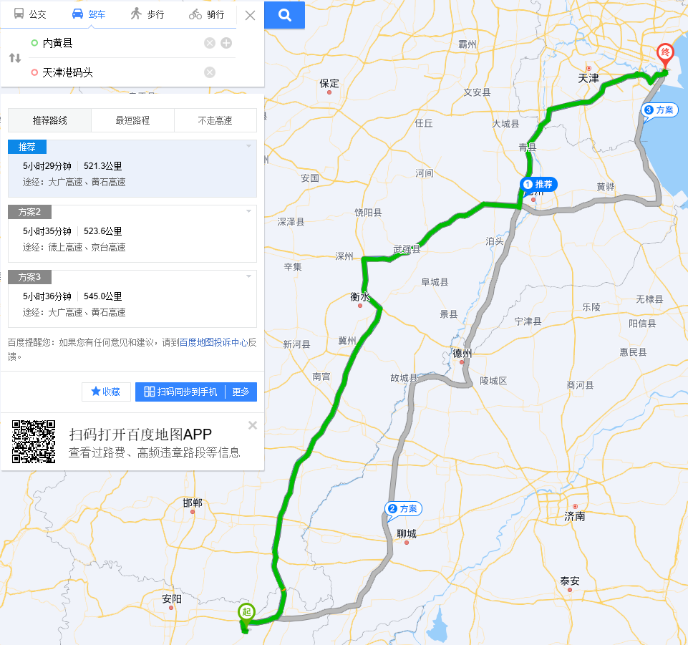
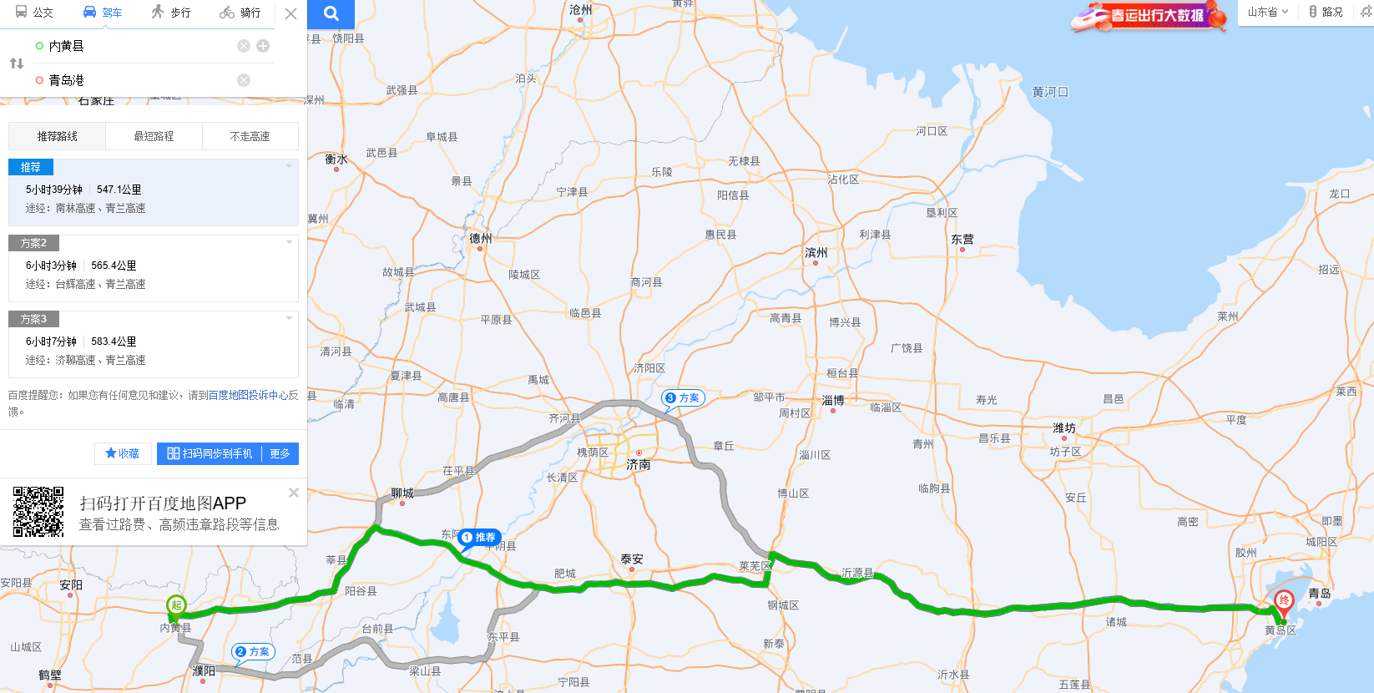
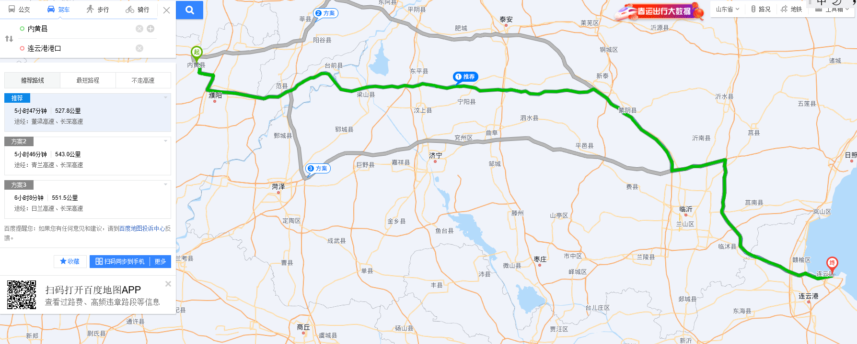
周边港口及距离
Surrounding ports and distance
距离天津港码头521km
521km away from Tianjin Port Terminal
距离青岛港547km
547km away from Qingdao Port
距离连云港港口528km
528km away from Lianyungang Port
Notes:
Elaborate within 2 slides on company background and history

Slide 11
工厂简介
Company/Factory Profile
工厂是在2024年3月份成立
Established: in 2024
工厂的建筑面积：15600平方米
Factory Size: about 15600 square meters
仓库面积：5600平方米
Storage/Warehouse Size: about 5600 square meters
员工人数（旺季和平均人数）：250/70
Number of employees(peak and average): 250/70
QA团队人员：5人
Quality Assurance Team: 5
2024公司销售额：$10,000,000
2024 Company Sales: US$ 10 million
Clas ohlson--40%, QVC--20%, Europris--40%,

Slide 12
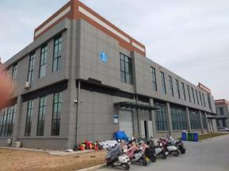
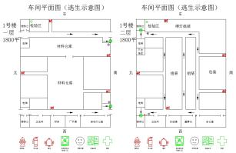
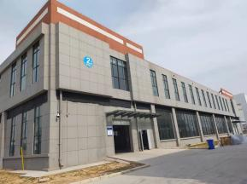
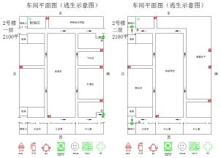
工厂总布局
General layout of the factory

Slide 13
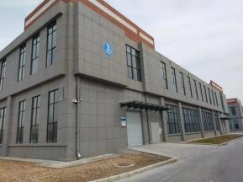
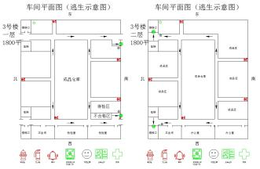
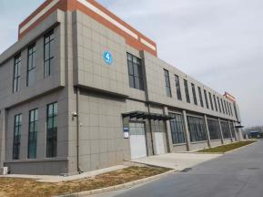
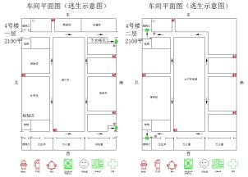
工厂总布局
General layout of the factory

Slide 14
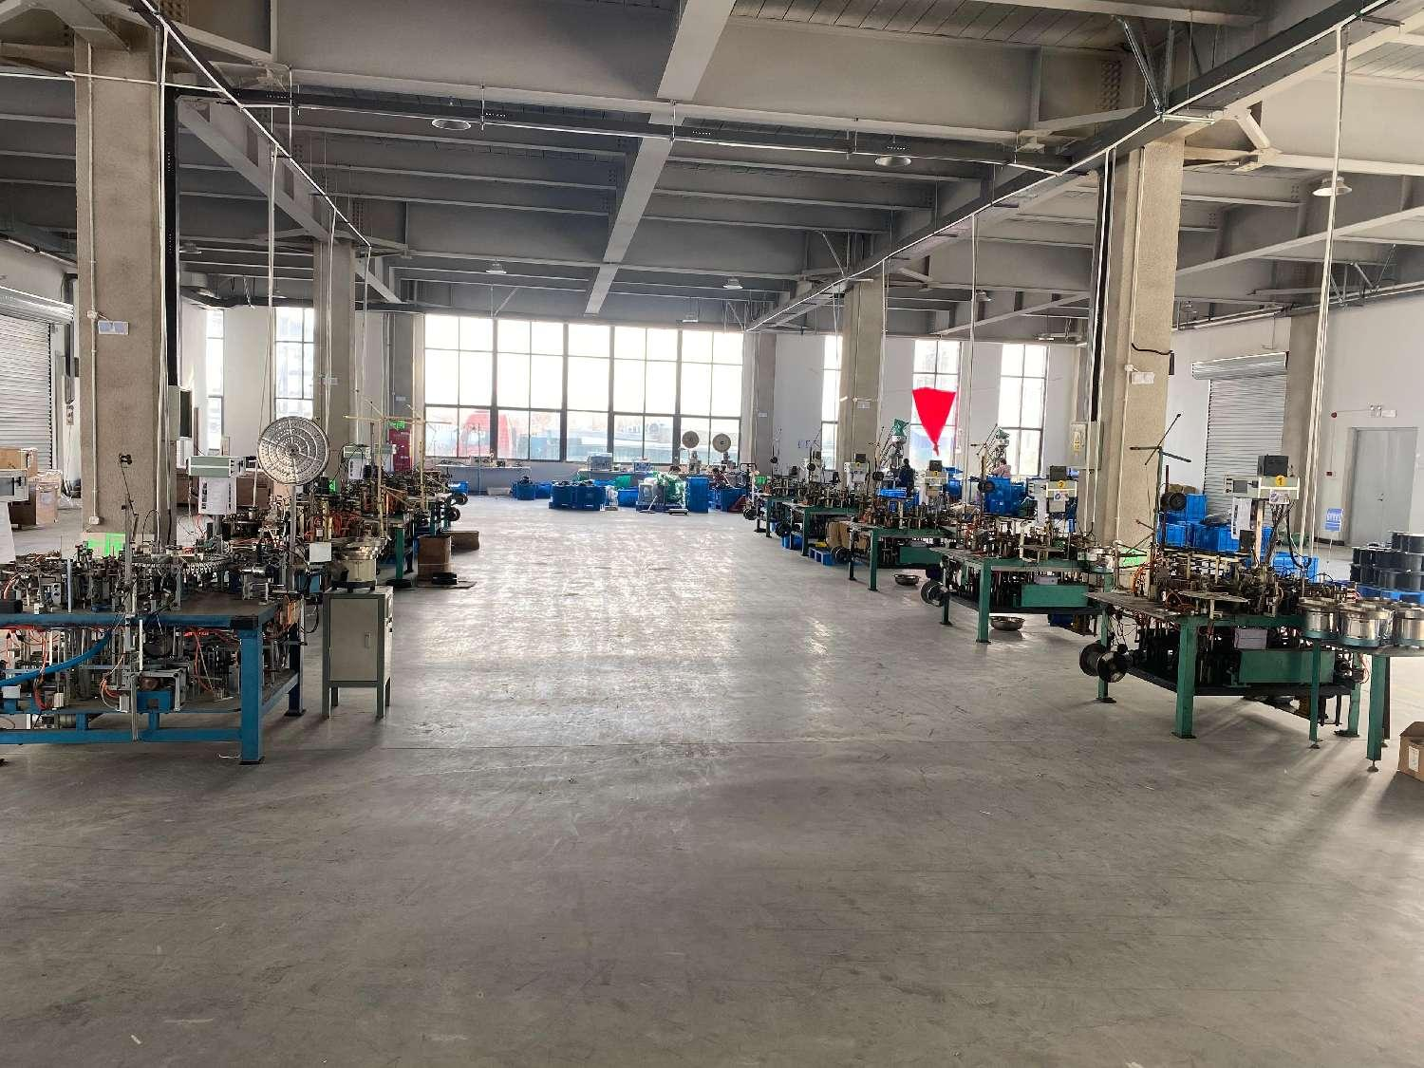
工厂简介
Company/Factory Profile
10台灯组自动焊接机
10 Automatic Assembly Machine
Notes:
Elaborate within 2 slides on company background and history

Slide 15
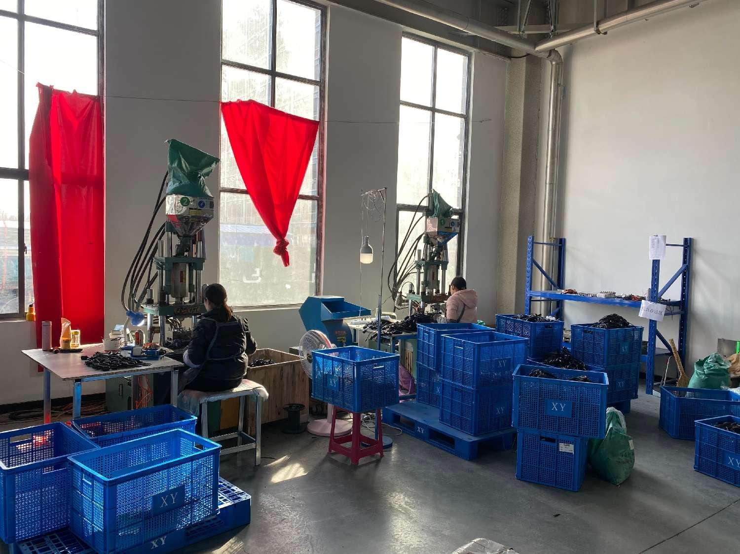
工厂简介
Company/Factory Profile
2台插头注塑机
2 plug Injection Machines
Notes:
Elaborate within 2 slides on company background and history

Slide 16
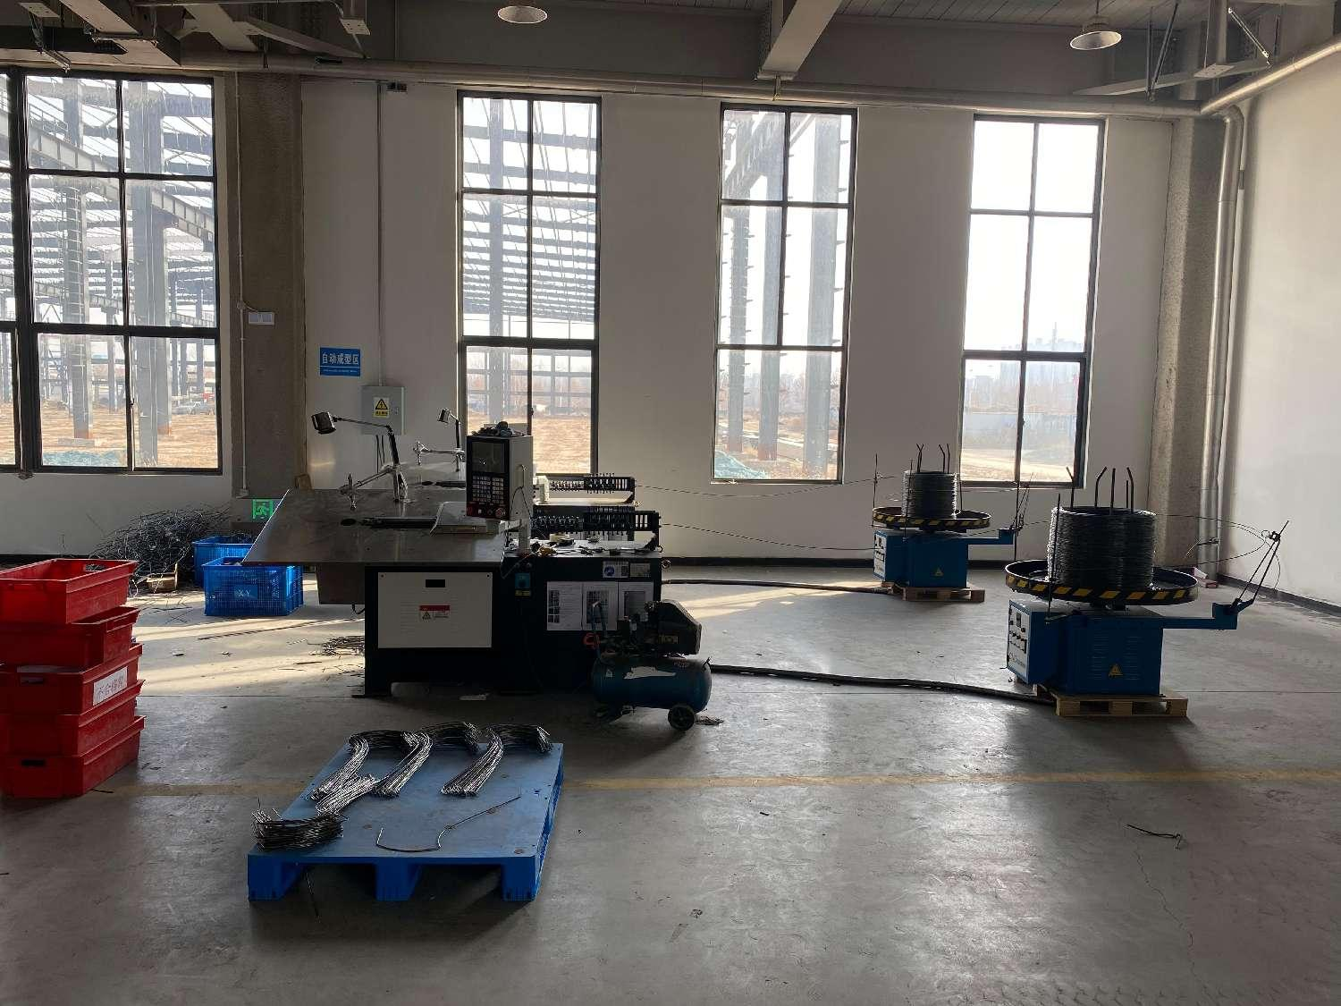
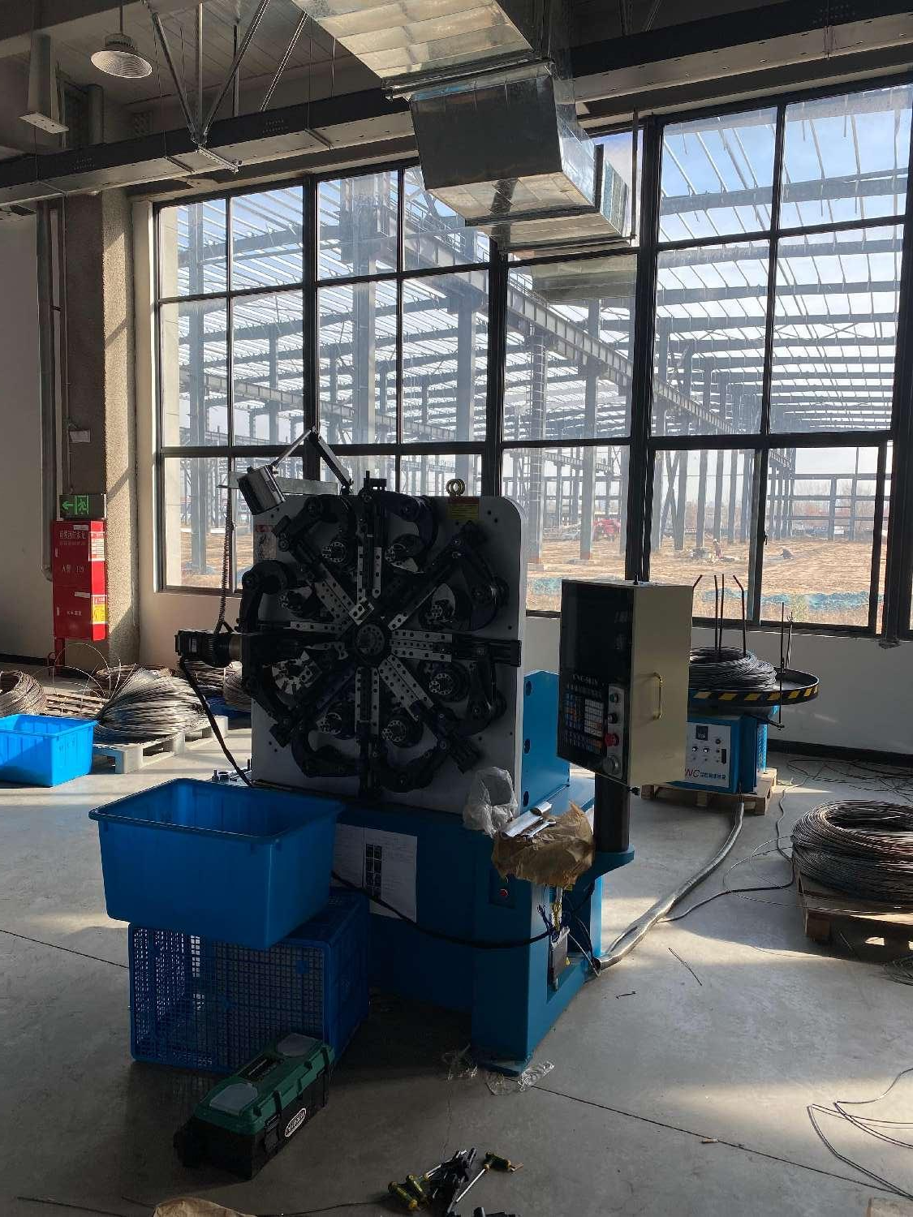
工厂简介
Company/Factory Profile
3台线材成型机
3 wire forming machines
Notes:
Elaborate within 2 slides on company background and history

Slide 17
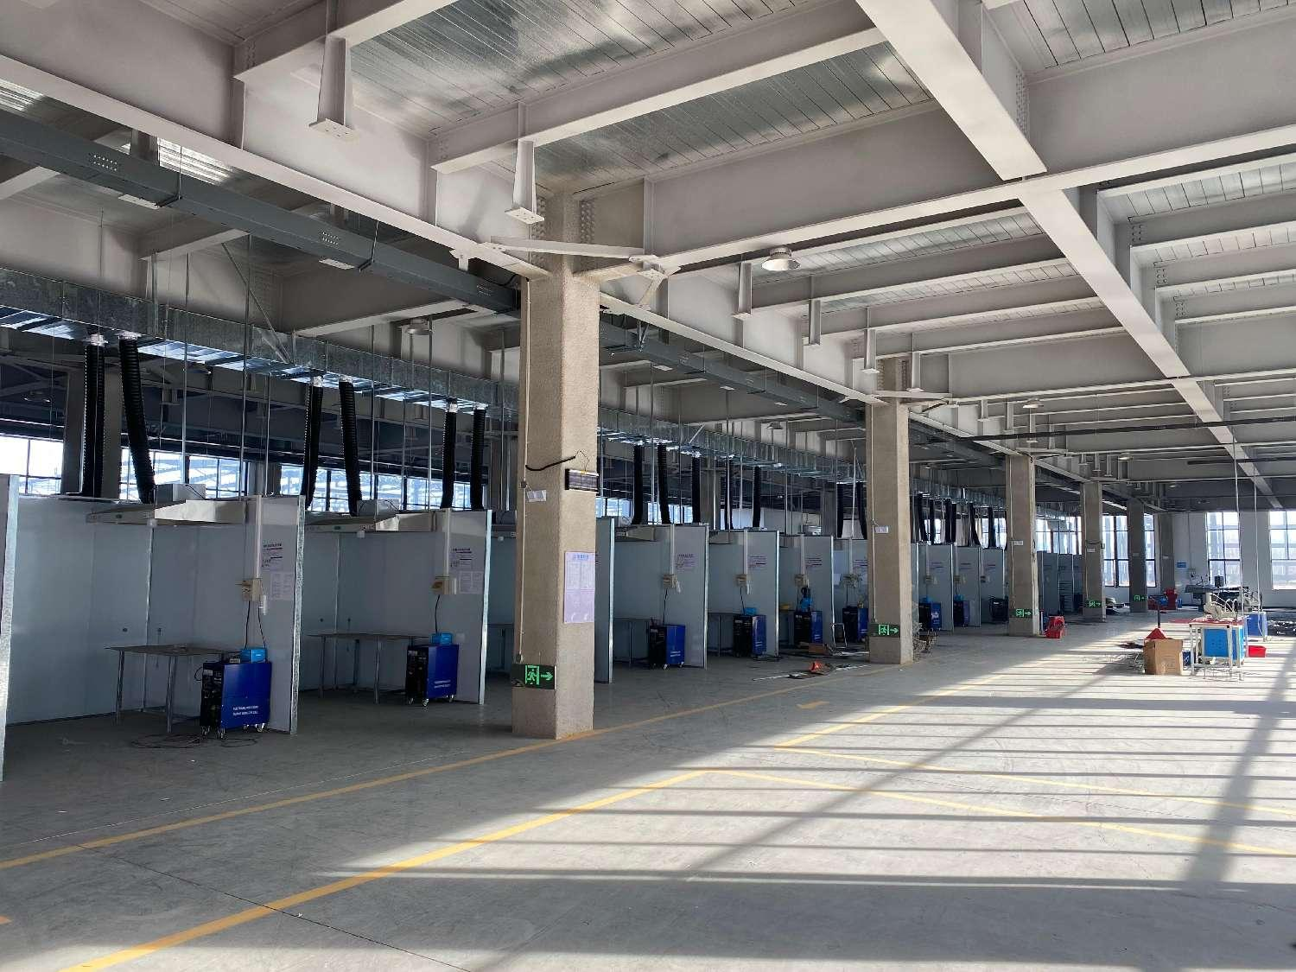
工厂简介
Company/Factory Profile
40个电焊工作台
40 welding workstations
Notes:
Elaborate within 2 slides on company background and history

Slide 18
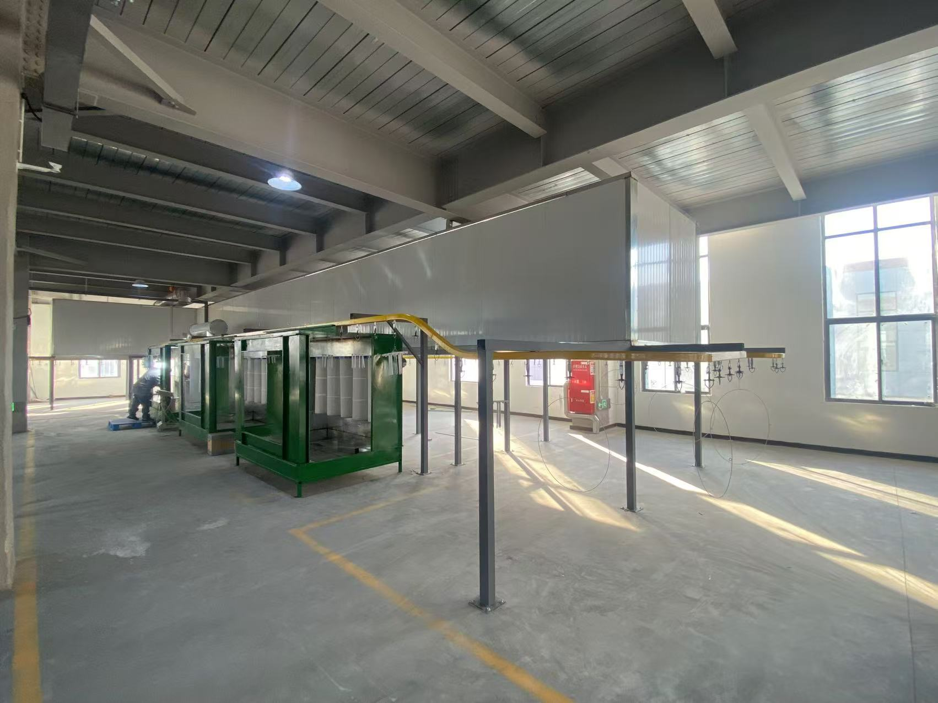
工厂简介
Company/Factory Profile
1条喷塑流水线
1 spray coating production line
Notes:
Elaborate within 2 slides on company background and history

Slide 19
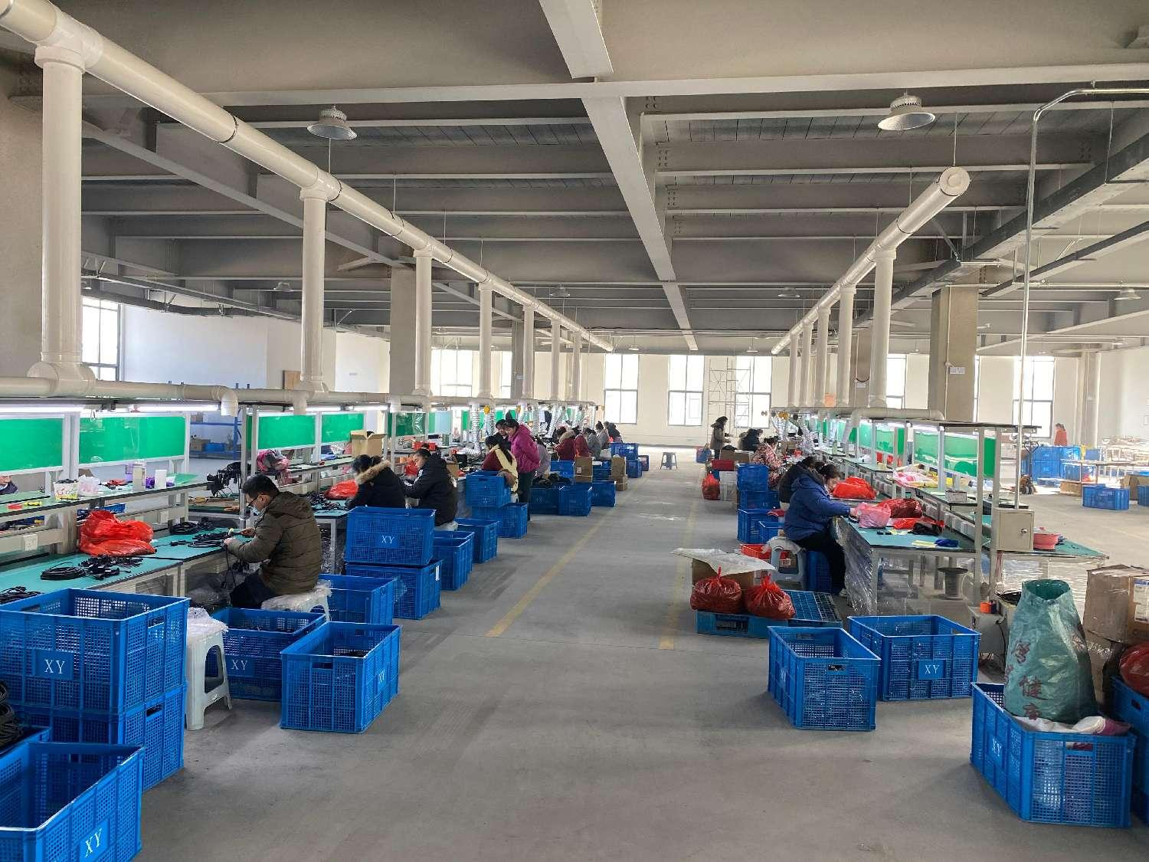
工厂简介
Company/Factory Profile
40条组装检验和包装生产线
40 Inspection / Packing Lines

Slide 20
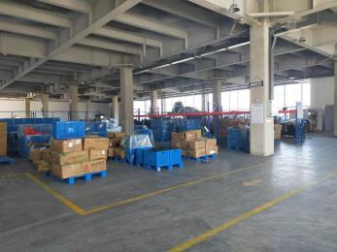
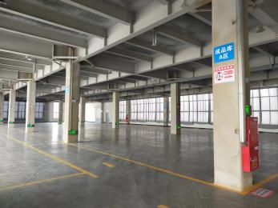
工厂简介
Company/Factory Profile
材料和成品仓库/Storage/Warehouse

Slide 21
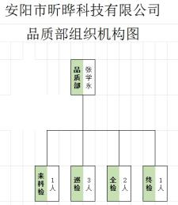
质量控制
Quality Control
QC组织架构图
QC organization chart

Slide 22
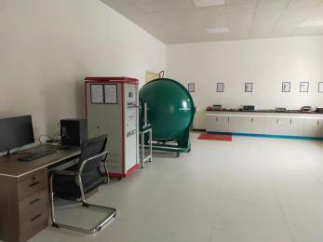
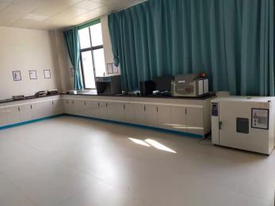
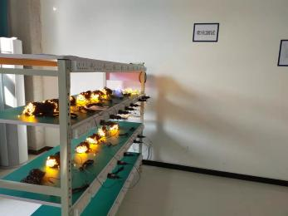
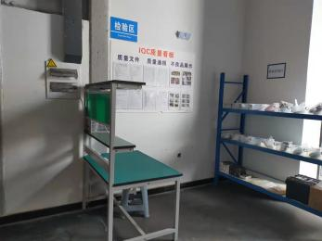
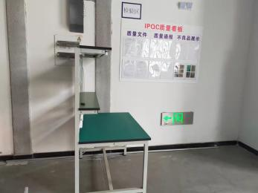
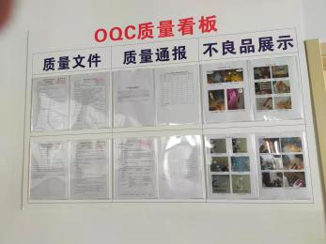
质量控制 Quality Control
Testing Lab

Slide 23
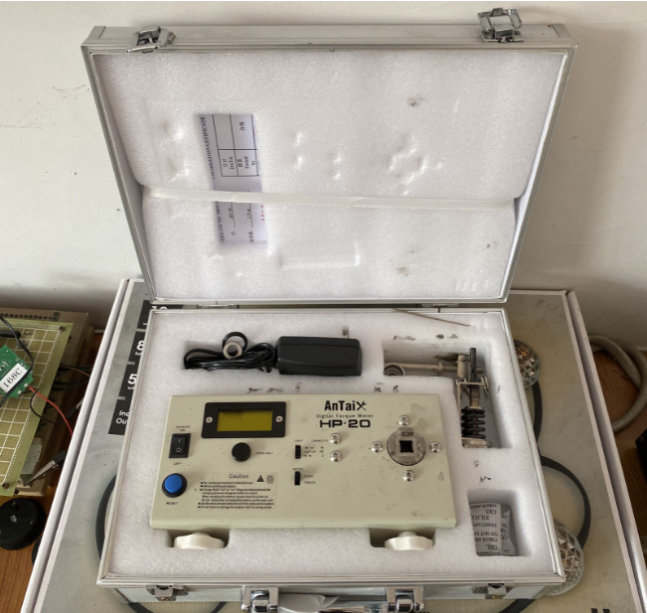
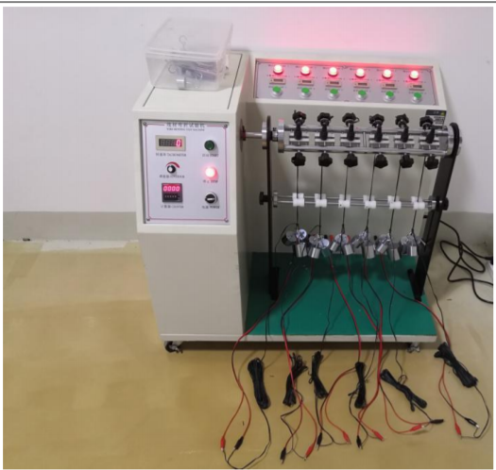
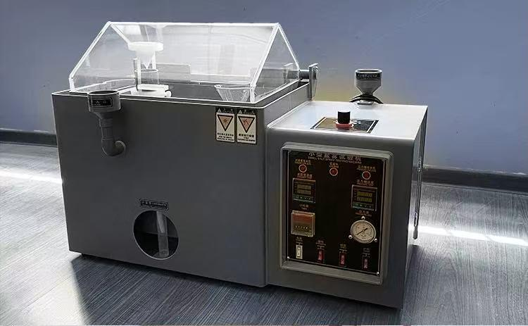
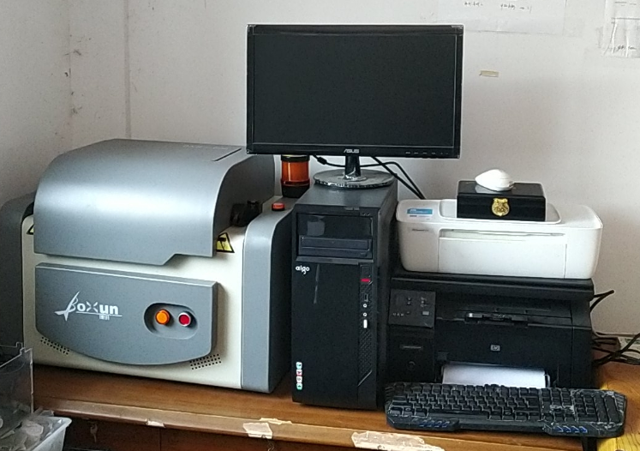
质量控制 Quality Control
Torque test
wiggle test
ROHS testing
Salt spray test

Slide 24
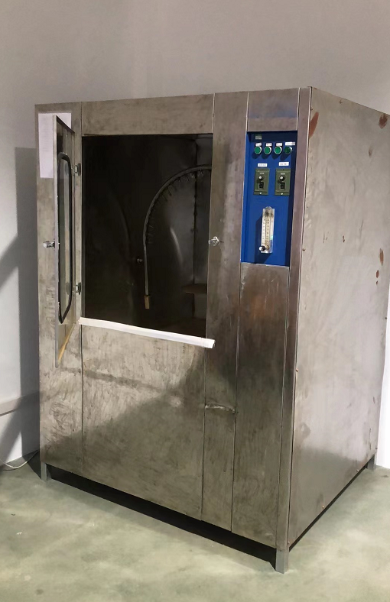
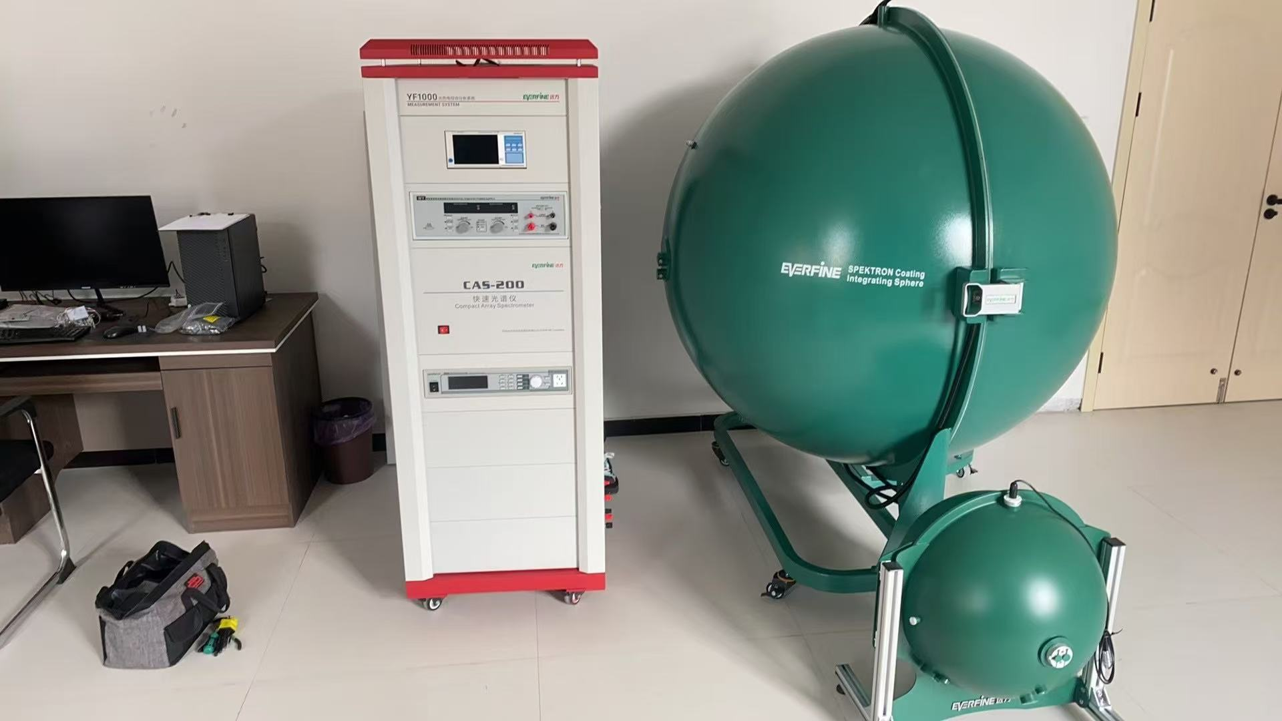
质量控制 Quality Control
Optical chromatography testing
IP44 Waterproof Test

Slide 25
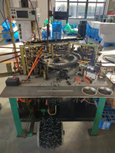
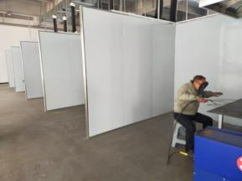
计划产能 Planned Capacity
LED welding
Maximum daily output: 400000 pcs
Iron wire forming
Maximum daily output: 5000 pcs
Electric welding forming
Maximum daily output: 4000 pcs

Slide 26
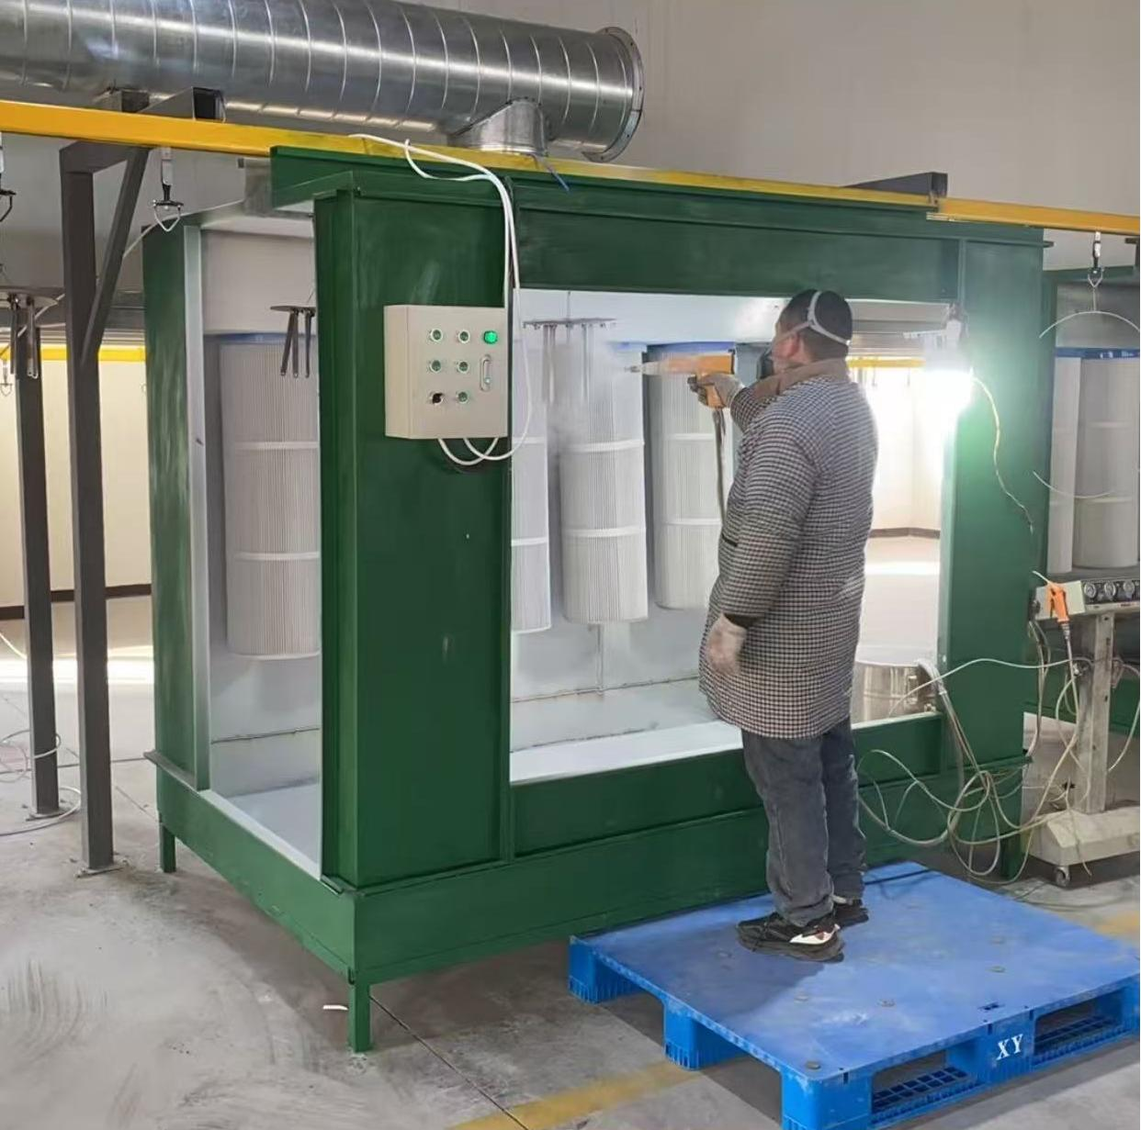
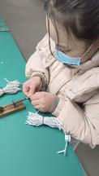
计划产能 Planned Capacity
Powder coating
Maximum daily output: 8000 pcs
Assemble
Maximum daily output: 3000 pcs
Package
Maximum daily output: 6000 pcs

Slide 27
优势和长项
Strengths/Competitive Advantages
有多年从业经验的的生产和品质管理人员 Production and quality management personnel with years of experience in the industry
有成熟的产业供应链 There is a mature industrial supply chain
充足且熟练的工人 Adequate and skilled workers
充足的仓储空间 Adequate storage space
紧跟趋势的开发团队 A development team that keeps up with trends

Slide 28
环境保护 environmental protection
For the waste gas generated during the production process, we collect it uniformly through pipelines, and after being centrally treated by advanced environmental protection equipment, it is discharged into the atmosphere to ensure that the impact on the environment is minimized

Slide 29
感谢观看，欢迎来访
Thank you for watching. Welcome to visit
We are constantly seeking better suppliers, improving product processes, and implementing scientific management to reduce production costs,Better serve customers with high-quality products and reasonable prices

